Slide 1
Generic Output Review Process for research projects Version 1.0, October 2022

Slide 2
Generic Output Review Process DOI: https://doi.org/10.57775/6jph-dt22
This Output Review process was developed as part of the International COVID-19 Data alliance (ICODA) initiative, which supported research projects that addressed major research questions relating to COVID-19. For more information on the ICODA projects please see our website.
A set of proportionate review processes were developed, all of which have been genericised and made available for re-use. They reflect that our research was taking place within a Trusted Research Environment, for more information please see our website.
ICODA as an initiative adhered to the 5-safes principles
This process is free to use and amend as needed by your organisation, we just request you attribute us…
Citation: International COVID-19 Data Alliance (ICODA). (2022). Generic Review Processes. International COVID-19 Data Alliance (ICODA). DOI: https://doi.org/10.57775/6jph-dt22
This process is offered on an as-is basis without any representation or endorsement made and without warranty of any kind.
This generic policy is based on: https://icoda-research.org/wp-content/uploads/2022/10/ICODA-Output-Review-Process-v2.1.pdf

Slide 3
Customising this process
Throughout the process document, we have highlighted areas which will need amending for your specific project
Typical areas that you will need to customise:
Your Organisation name
The Work Area your research project will be performed in and the Provider of that Work Area
Your Expert Groups and Committees
Contact details, e.g. Email addresses

Slide 4
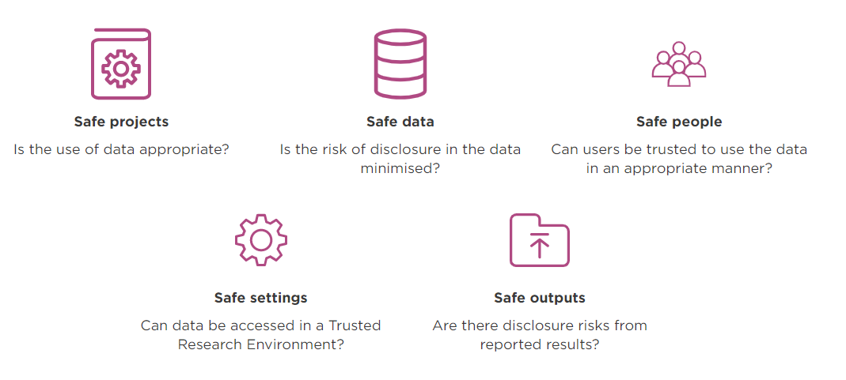
[ORGANISATION] has committed to the ‘Five Safes’ Framework

Slide 5
Purpose of the Output Review Process
[ORGANISATION] expects a high standard of accountability from researchers, and the Output Review process forms part of this expectation
Purpose:
To ensure Safe Outputs, i.e. ensure there are no disclosure risks from output generated and exported from the [WORK AREA]
To validate scientific integrity of results (as required)
This document outlines the different levels of output review, review elements and who is responsible
Output review comprises two components:
Disclosure review – review and remediate potentially identifiable information - conducted in researcher’s work area
Results review – ensure scientific integrity and reassure data contributors – potentially conducted in separate work area/s

Slide 6
Output Review Process
1. Results generated in [WORK AREA]
2. Disclosure review – no identifiable data (mandatory)
4. Results exported
3. Results review (optional)
If a review is not approved, feedback will be shared with researchers, who will have an opportunity to amend and resubmit
Responsible
Mandatory:
PI / Work area Admin*
If required:
[ORGANISATION]/
[EXPERT GROUP/COMMITTEE]
Researchers
[EXPERT GROUP/COMMITTEE] /
External Reviewers/ Community Reviewers/
Data contributors
No individuals identifiable in results (e.g. no names, DOBs, addresses, telephones, email addresses, patient identifiers or other unique identifiers)
Should consider any linkage that may be possible from results with other data sets
*PI to submit measures undertaken to minimise disclosure to [ORGANISATION]
Check results are sound (no unexplained anomalies)
Under exceptional circumstances:
Recreate Workspace with data, models & tools
Re-run analysis
Check results match those awaiting output
Irrespective of whether this step is requested, the PI retains responsibility for scientific integrity of results
2 weeks for Disclosure review; 2 further weeks if Results review required

Slide 7
2. Worked example for Disclosure Review only
1. Results generated in [WORK AREA]
2. Disclosure review – no identifiable data (mandatory)
3. Results review
(optional)
4. Results exported
The following steps are envisaged:
Researcher requests Workbench airlock
PI / Workspace admin does disclosure review check and, if satisfactory, informs [ORGANISATION]
If required, PI / Workspace admin requests further external disclosure check by [ORGANISATION] or Expert Group member
[ORGANISATION] identifies and designates appropriate [ORGANISATION] or Expert Group member to perform the external disclosure review
[ORGANISATION] informs PI / Workspace admin who to invite into the Workspace airlock
External disclosure review is performed by responsible [ORGANISATION] or Expert Group member
If no identifiable elements are found
Review is completed and logged [template issued on request]
Reviewer informs [ORGANISATION] that review is complete with no issue
[ORGANISATION] authorises PI / Workspace admin to allow airlock export
If identifiable elements are found:
Review is completed and logged [template issued on request]
Reviewer informs [ORGANISATION]
Research team informed of issues by [ORGANISATION] and asked to remediate
Process repeats
*In a Federated analysis scenario, additional Disclosure checks may be performed by the Data custodian before analysis results are returned

Slide 8
3. Worked example for Results Review
1. Results generated in [WORK AREA]
2. Disclosure review – no identifiable data (mandatory)
4. Results exported
3. Results review
(optional)
As per 2. Disclosure review, then additionally, the following steps are envisaged:
[ORGANISATION]/PI identifies Results review is necessary* or has been requested
If required, PI adds external reviewers to the existing [WORK AREA]
If results recreation required (extremely exceptional):
[ORGANISATION] informs [WORK AREA PROVIDER] Results review is necessary, specifying Work area(s) required for the review & their members*
[WORK AREA PROVIDER] arranges provisioning of review [WORK AREA]
, transfer of data and methods to review [WORK AREA] working with PI
Reviewer(s) invited to review [WORK AREA]
Results Review performed by Reviewer(s)
If results are acceptable
Review is completed and logged [template issued on request]
Reviewer(s) inform [ORGANISATION]
[ORGANISATION] authorises [WORK AREA PROVIDER] to allow airlock export
If adjustments are required
Review is completed and logged [template issued on request]
Reviewer(s) inform [ORGANISATION]
Research team informed and asked to make changes
Process repeats
*See chart 8

Slide 9
When is an external Disclosure Review required?
The Disclosure Review step is undertaken to ensure Safe Outputs, i.e. ensure there are no disclosure risks from output generated and exported from the Work area
The PI Research Lead/Work area admin is responsible for Disclosure review in most cases
The external Disclosure Review step is taken when:
Mandated by the Data Contributor
Recommended by the Expert Review Panel who reviewed original project proposal, due to:
Access to sensitive / controversial data
Sample size, rarity of events, geographic area, availability of other data than could be linked to re-identify individuals etc
Requested by the PI / Research Lead, with rationale
The external Disclosure Review step may involve one or more, or combinations of:
[ORGANISATION] personnel
Expert Group member reviewer(s)
Who performs an external Disclosure Review?

Slide 10
When is a Results Review required?
The Results Review step is undertaken to ensure research is robust and high quality
The PI Research Lead is responsible for reviewing their own results in most cases
The Results Review step is taken when:
Mandated by the Data Contributor
Recommended by the Expert Review Panel who reviewed original project proposal, due to:
Access to sensitive / controversial data
Sample size, rarity of events, geographic area, availability of other data than could be linked to re-identify individuals etc
Potential to generate controversial results
Requested by the PI / Research Lead, with rationale
The Results Review step may involve one or more, or combinations of:
Data Contributor reviewer(s)
[EXPERT GROUP/COMMITTEE] reviewer(s)
External reviewer(s)
Open Community Reviewer(s)
Who performs a Results Review?

Slide 11
Guidance

Slide 12
Standards for Researchers
[ORGANISATION] expects a high standard of accountability from researchers, and the output review process is in addition to this expectation
Researchers are responsible for safe outputs
Researchers must be [ORGANISATION] accredited and have completed their onboarding training
Researchers must check data and outputs to ensure they are safe and in line with project approval
Researchers must provide documentation for reviewers to understand outputs
Researchers should minimise Results Review requests

Slide 13
Instructions for PIs/Work area admins performing Disclosure Reviews
Send an email to: [ORGANISATION EMAIL]
Email Title: Disclosure review – Output
Please include in the email:
Your Project Name:
Your Project Lead:
Date of review:
Who performed the review:
Please detail the checks undertaken:
Any concerns or comments:
Please confirm that the output contains no identifiable data: Yes/No

Slide 14
Output Review Standards for Reviewers
Reviewers are responsible for only releasing results they understand and have confidence are not disclosive
Results should be reviewed in a timely manner to ensure optimal benefits from data
Reviewers are responsible for clarifying issues to understand Results Review request
Rejected Results Review requests require clear explanation
Output Reviews will be conducted by a minimum of 2 reviewers
Each reviewer is expected to conduct an independent review in keeping with guidance
If reviewers disagree, a senior reviewer will review and aim to reach agreement. Results will be exported when all reviewers agree it is a 'safe output'.

Slide 15
Disclosure Review Reviewers’ standards & checklist
Analysis approach
Is in line with project approval and data sharing agreements
Performed within the [ORGANISATION] [WORK AREA] – only results have been exported
Data Checking & Disclosure Control
No data or Individual-level data exported
Cells analysed shall not contain a value less than 5
Zero is not permitted where there is potential for disclosure
Maximum or minimum values are not permitted where there is potential for disclosure related to outliers associated with single individual
Graphs and other visualisations are subject to the same criteria as numeric results, where exact values can be determined
Nothing that could be used for performance tracking of individual organisations is permitted
Data Contributor requirements
Ensure data contributor attributions and restrictions are met
Checks should be aligned with the SDC Handbook (securedatagroup.org)

Slide 16
Results Review Reviewers’ standards & checklist
As for Disclosure review with additional steps:
Results check
Results inspection – eyeball for obvious anomalies, unexplained or spurious results
Re-run analysis on obvious anomalies, unexplained or spurious results
Run spot check analysis
Double check research question results are answered
Ensure sensitive results are correct and robust
Facilitate PI engagement with data contributors
Appraise data contributor of potential controversy or sensitivity on publication
There is a sense check with and validation from the data contributor pre-publication
Checks should be aligned with SDC Handbook (securedatagroup.org)

